Slide 1
Outfit Recommender using Machine Learning
By Joseph Mckeown

Slide 2

The Problem
The average person can find it difficult to
choose what to wear.
Today we are often overwhelmed by the
amount of choice
Modern technology can be used to streamline
this process
We can use a Neural network to learn our tastes in our clothes

Slide 3
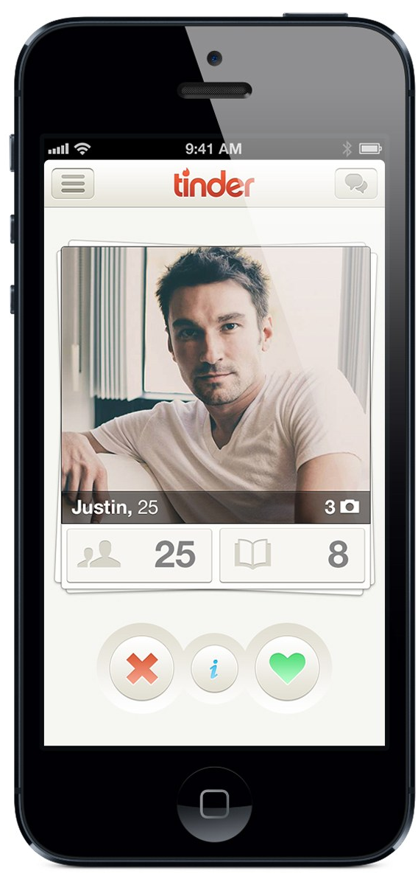
The Solution
An application which has a virtual wardrobe that will suggest outfits
Allows users to store picture of their clothes
The App will recommend outfit to the user from their clothes in a similar style to how modern dating apps do e.g. tinder
It will also incorporate a neural network, to learn the users taste

Slide 4
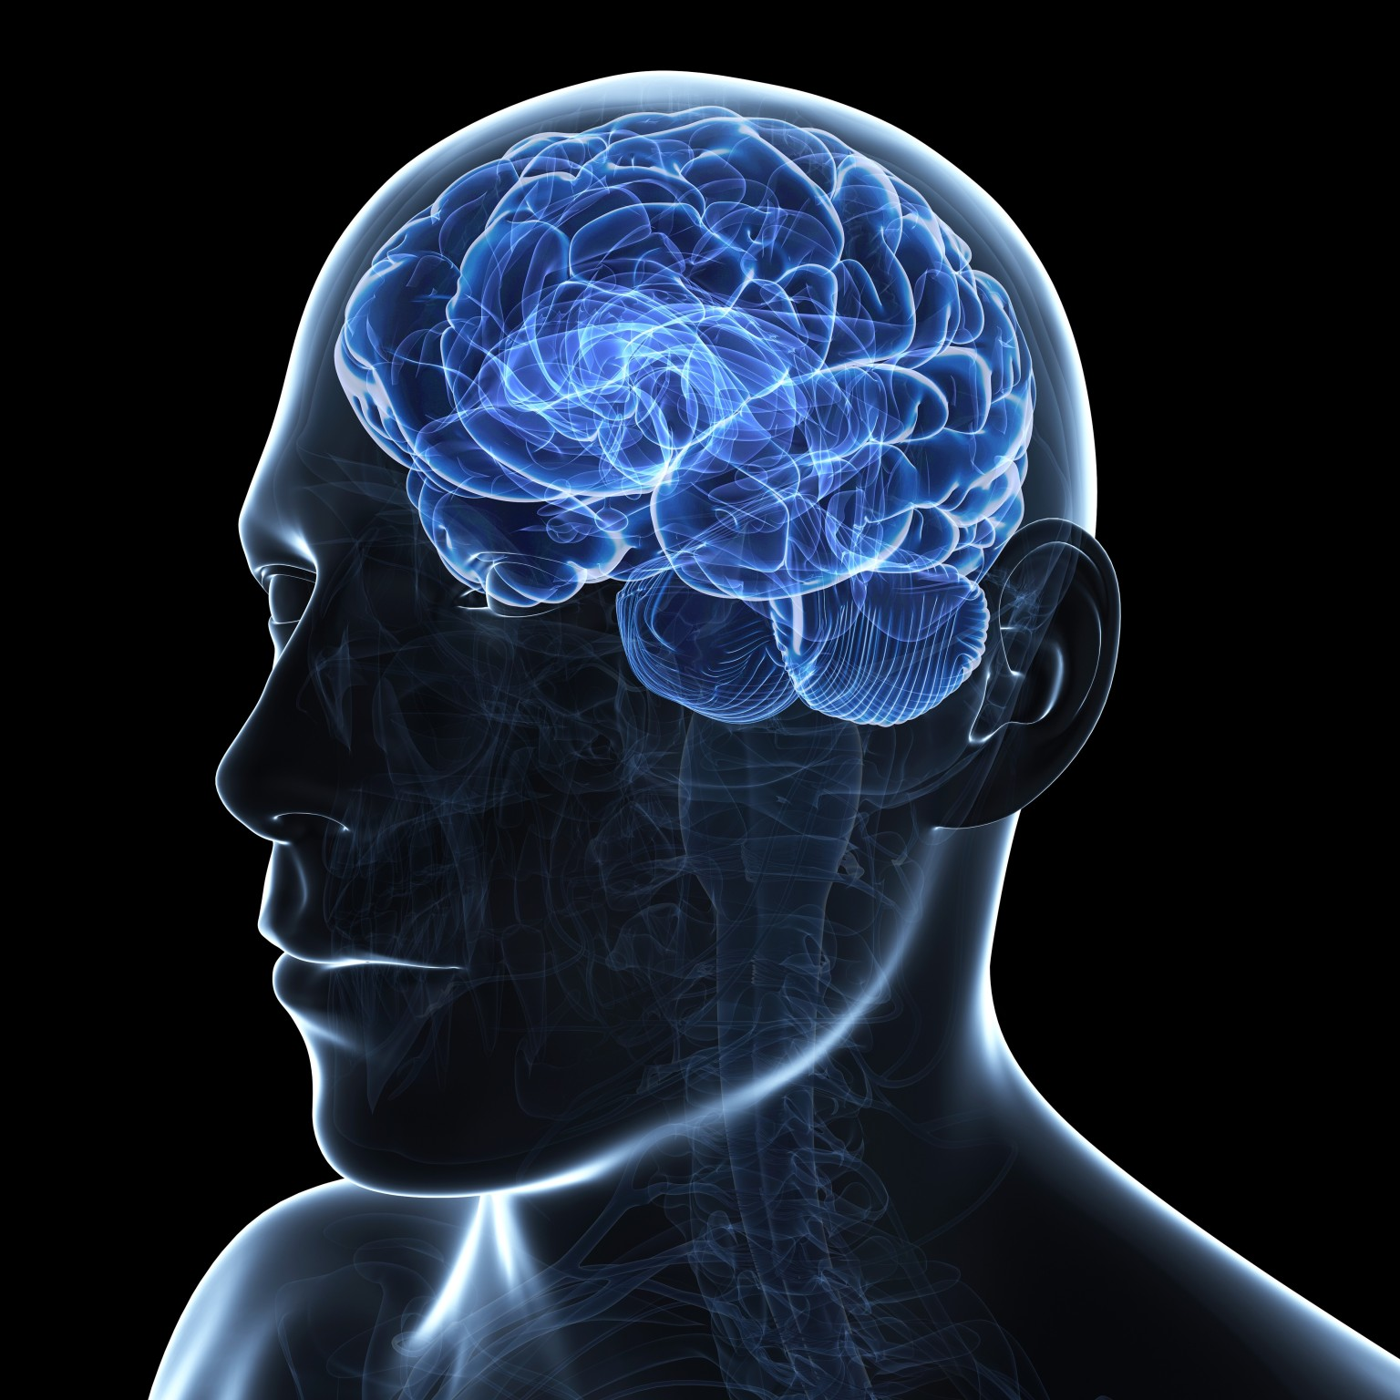
Why a Neural Network
It will improve users satisfaction will improve with the outfits chosen
Learning the users taste will help find which items of clothing and outfits they may like and dislike
It will adapt to the user and their ever evolving tastes

Slide 5
History of Neural Networks
The study started in the 1940s with Warren McCulloch and Walter Pitts
Created the first computational model for Neural Network
In the 1974 Webos discovers multiple layer perceptron's can solve no linearly separable problems.
Multiple layer neuron network discovered to be able to learn more complicated problem and started development into deep learning

Slide 6
Machine Learning Neural Networks
Creating an algorithm which acts similarly toa human brain
A basic model has:
Inputs
Weights
Bias
Output
Neuron
The neuron stores the sum of the Inputs * the Weights.
Like a human synapses, if the sum of the inputs reaches the threshold the output become 1
w
x
1
bias, w₀
1
w
x
2
Inputs
2
Output
w
x
n
n

Slide 7
Machine Learning Neural Networks
With problem a neural network can solve, they can be linearly separable or non linearly separable
A regular linear layer network can not solve non linearly separable problems
Non linearly separable problems can be solved by using a Multiple layer network
w₁(0,0)
x₀(0)
w₁(1,0)
x₁(0)
w₂(1,0)
w₂(0,0)
w₁(2,0)
x₂(0)
w₁(0,1)
w₂(2,10)
w₁(1,1)
x₀(1)
w₁(2,1)
x₁(1)

Slide 8
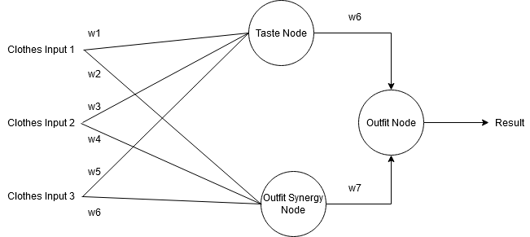
My Neural Network
For the solution, I designed a MLP network.
In the hidden layer, the nodes represent the Output for the individual taste in an outfit and the Synergy of an outfit respectively
The results being the combination of both of these results
The network is not fully connected

Slide 9
First Prototype Algorithm
This was designed to look like the MLP diagram from before
It worked by having all possible clothes connected to 2 nodes in the hidden layer representing the both taste and Synergy
This would connected to a final output node which would contain the rating of the outfit
Once all the outfits rating were calculated, A probability was assigned to each outfit proportional to their rating.
Then a random outfit is chosen
If the user likes the outfit, that outfit’s weight would be adjusted positively and visa vera for it the outfit is rejected.

Slide 10
Creating a test profile
To test the success of the algorithm, a personal profile needed to be created.
A personal profile is a fictional person with a fictional wardrobe and tastes which dictate what their responses are.
This can be a profile who has 2 shirts with 3 jeans and he loves wearing shirt 1 with jeans 3 so will always pick that combination while hating shirt 2 with jeans 3 and will in tow always reject this combination.

Slide 11
Testing the First Prototype Algorithm
Once the testing profile had been created, I set my testing parameters.
I would test the algorithm against my profile with varying levels of train. These went from 0 – 100 epochs of training in division of 10.
After training, I would then rate the next 10 suggestions and create a score out of 10 on how many outfits were found to have been to the profile’s taste
Due to the nature of randomness introduced due to the selection process, the test at each epoch was repeated 5 times with the score averaged out.
The goal is for the score to be as high as possible with the least amount of training while remaining consistent

Slide 12
First test – Default values(LR 0.2, Initial weight 0.5, )
This is the algorithm learning with it’s default setting
There seem to be an overall upwards trend to greater accuracy as the first output remains the lowest value, the highest values come towards the higher levels of training
Not a smooth learning curve as seen with results as 60

Slide 13
Hidden layer test – (LR 0.2, Initial weight 0.5, Increased LR for Hidden Layer)
This test the algorithm with a higher learning rate in the hidden layer
Similar to before there is a general upwards trend but unlike default it is much smoother in it upwards curve.
Still some anomalies with the large dip at 50 epochs

Slide 14
Lowered LR– (LR 0.1, Initial weight 0.5 )
This test the effect of lowering the learning rate of the weights for the inputs.
This shows a much more chaotic spread of scores which displays the unreliability introduced
There still seems to be a overall upward trend but the results keep fluctuating with results from 30 – 50 epochs
Shows that this is not very effect for the algorithm and will lea to more dissatisfaction due to the unreliability

Slide 15
Conclusion from testing
It discovered that generally most test cases showed a trend of learning the taste meaning that it was learning the problem to some extent.
There seems to be a limitation in learning at around 7/60% accuracy as most test result never seemed to consistently exceed this bound.
The greatest impact to learning is seen through the taste and synergy layer learning rates being increased
The randomisation of output may be more of detriment to learning than a positive in to reducing repetition due the amount of variance seen in lots of the results.

Slide 16
Improving the Algorithm
Due to limitation in the previous version of the Algorithm, I introduced some changed to try and fix these issues.
I changed the network structure to work more like a traditional MLP model.
I separated the inputs into 2 categories, individual clothes and Outfits. Now item of clothing would have separate weight and input values from the overall outfits.
Standardised the inputs so that only the selected item has an input of 1 when being used allowing for the node to be fully connected.
Also introduced momentum into the weight changing algorithm which adds the previous change of weights multiplied by a momentum value to the current change in weights.

Slide 17
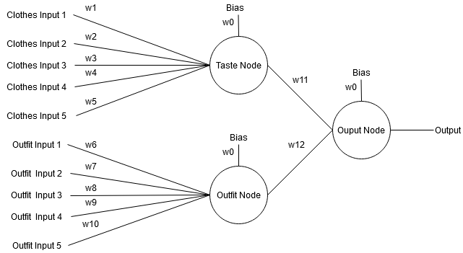
New look to the Neural network

Slide 18
For the Future
I want to fully implement this new system designed before hand.
To create a UI for the algorithm in a similar style as early tinder UIs were designed.
To create more intricated personal profiles and expand how testing is conducted.
To created setting for the algorithm which will produce high satisfaction.

Slide 19
Thank you for listening

